Slide 1
Part 1
Introduction

Slide 2
What Did I Get Myself Into?
Background of D.J. Jacobs
“Basic Research is like shooting an arrow into the air and where it lands, painting a target” --- Homer Adkins
Trained as a condensed matter physicist.
Ph.D. Thesis: Brownian motion in static disordered media.
Expertise in statistical and computational physics.
1st postdoc: Hydrodynamic properties of fluids
2nd postdoc: Rigidity percolation and glass networks (solids)
Faculty: Mechanics and Thermodynamics of Proteins

Slide 3
Why Study Protein Stability and Flexibility?
Personal Motivations
A subject involving many different physical principles that involve statistical physics and chemical thermodynamics.
Predicting stability and flexibility is a very difficult problem, and requires bridging multiple disciplines.
A small degree of improvement is often important, which could make a big impact in practical applications.
“Study hard what interests you the most in the most undisciplined, irreverent and original manner possible.” --- Richard Feynman

Slide 4
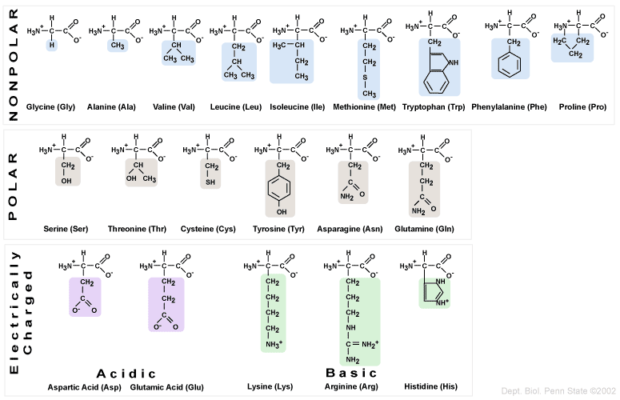
Introduction to Protein Structure
Building Blocks of Proteins: The 20 Amino Acids

Slide 5
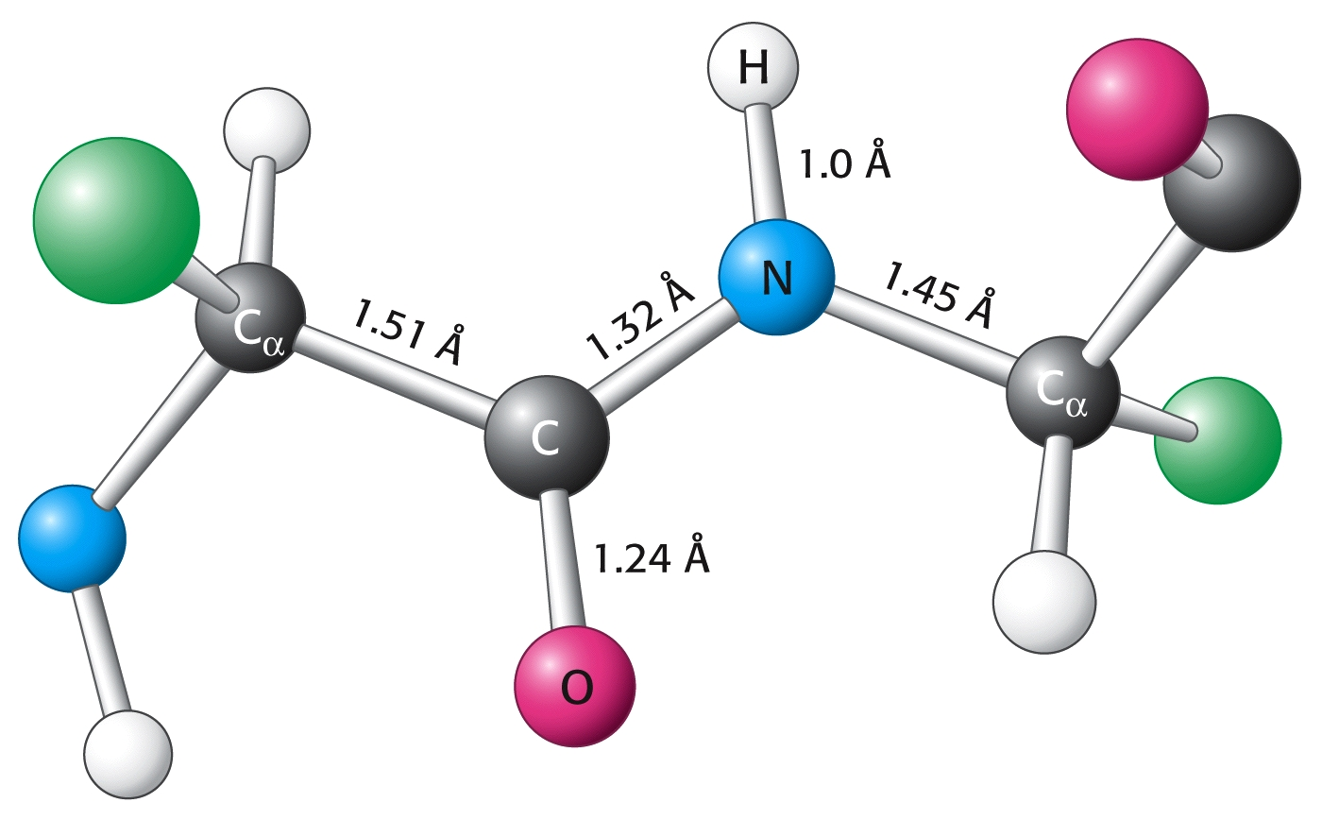
Introduction to Protein Structure
Peptide Bonds Connect the Building Blocks
side group
side group

Slide 6
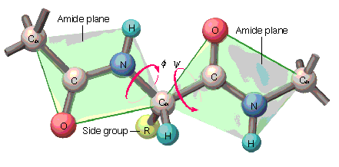
Introduction to Protein Structure
Peptide Bonds Connect the Building Blocks
residue

Slide 7
Introduction to Protein Structure
Flexible Backbone of a Protein
R
R
O
H
H
ϕ₁
ψ₁
H
ϕ₃
ψ₃
Cα
N
C
Cα
C-terminus
H
N
C
Cα
N
C
H
ϕ₂
ψ₂
H
H
H
O
O
R
N-terminus
Most side chains also have internal degrees of freedom {χ_{i}}
The set of {ϕ_{i},ψ_{i}} angles define internal degrees of freedom

Slide 8
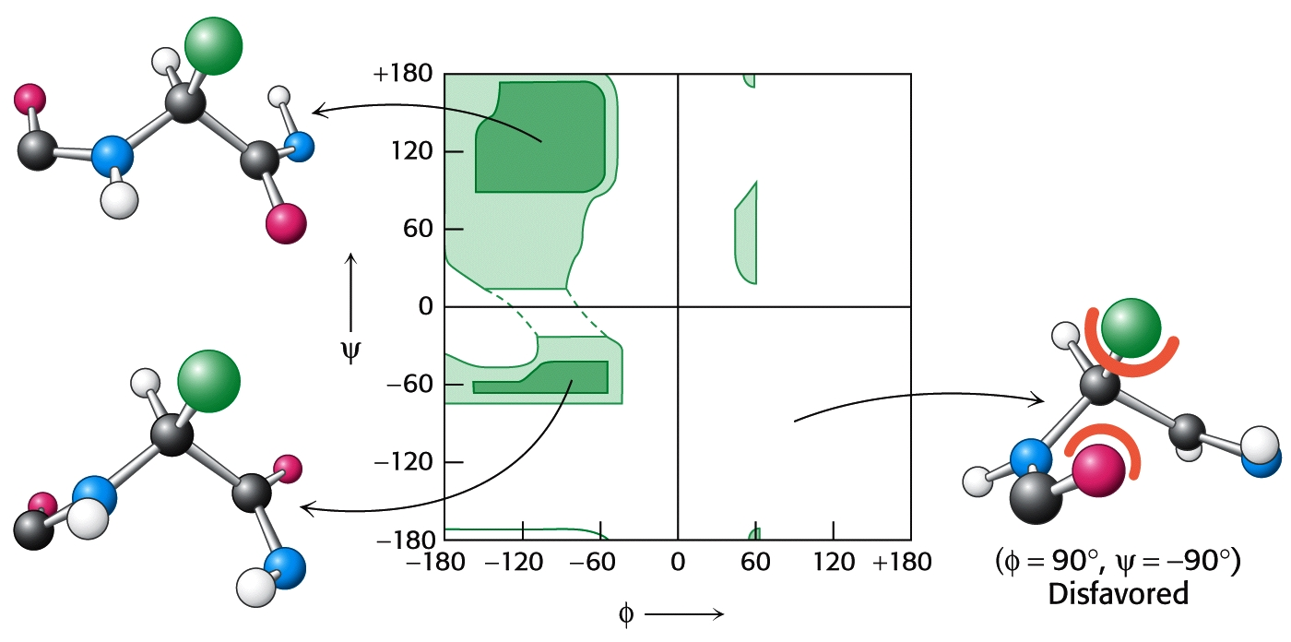
Introduction to Protein Structure
Steric Restrictions on PHI and PSI Angles
Ramachandran Plot for Typical Residue

Slide 9
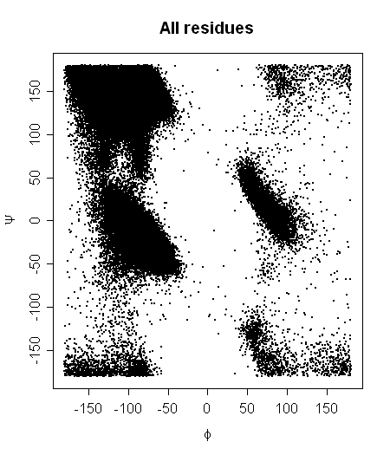
Introduction to Protein Structure
Steric Restrictions on PHI and PSI Angles

Slide 10
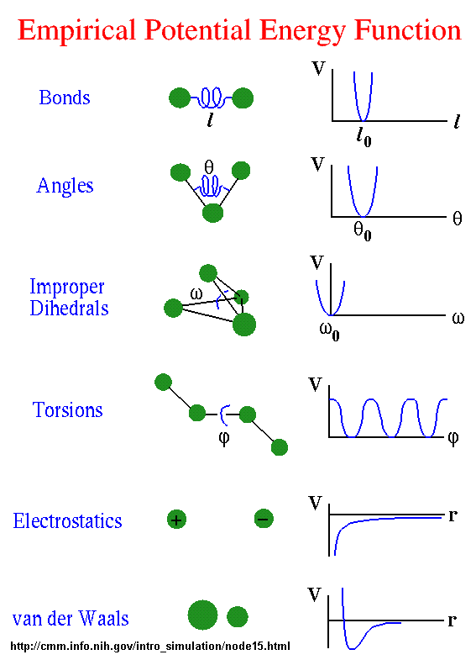
A protein is a collection of atoms that interact.
These interactions are modeled based on molecular mechanics force fields that define the potential energy function.

Slide 11
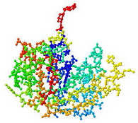
Introduction to Protein Structure
All atom ball-and-stick view of three dimensional structure

Slide 12
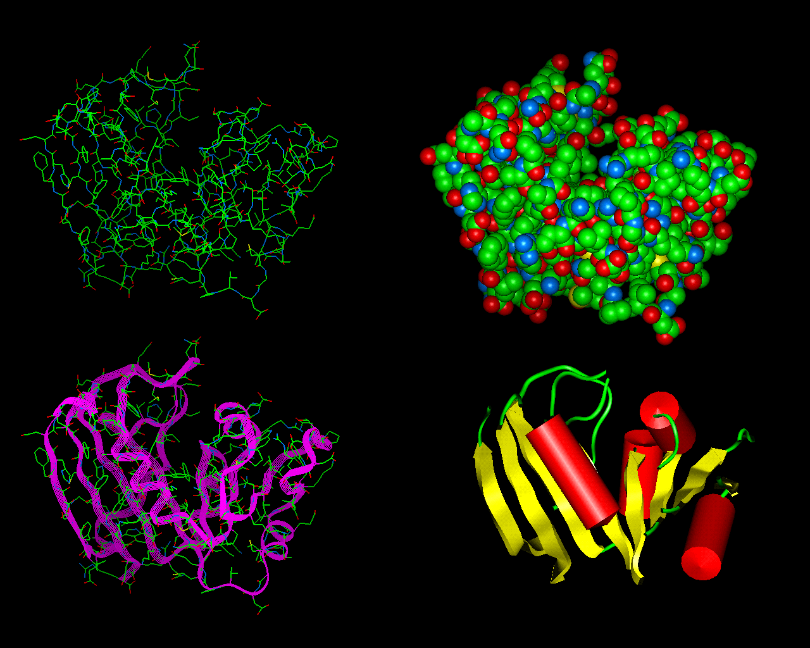
Introduction to Protein Structure
Hierarchical way of visualizing three dimensional structure

Slide 13
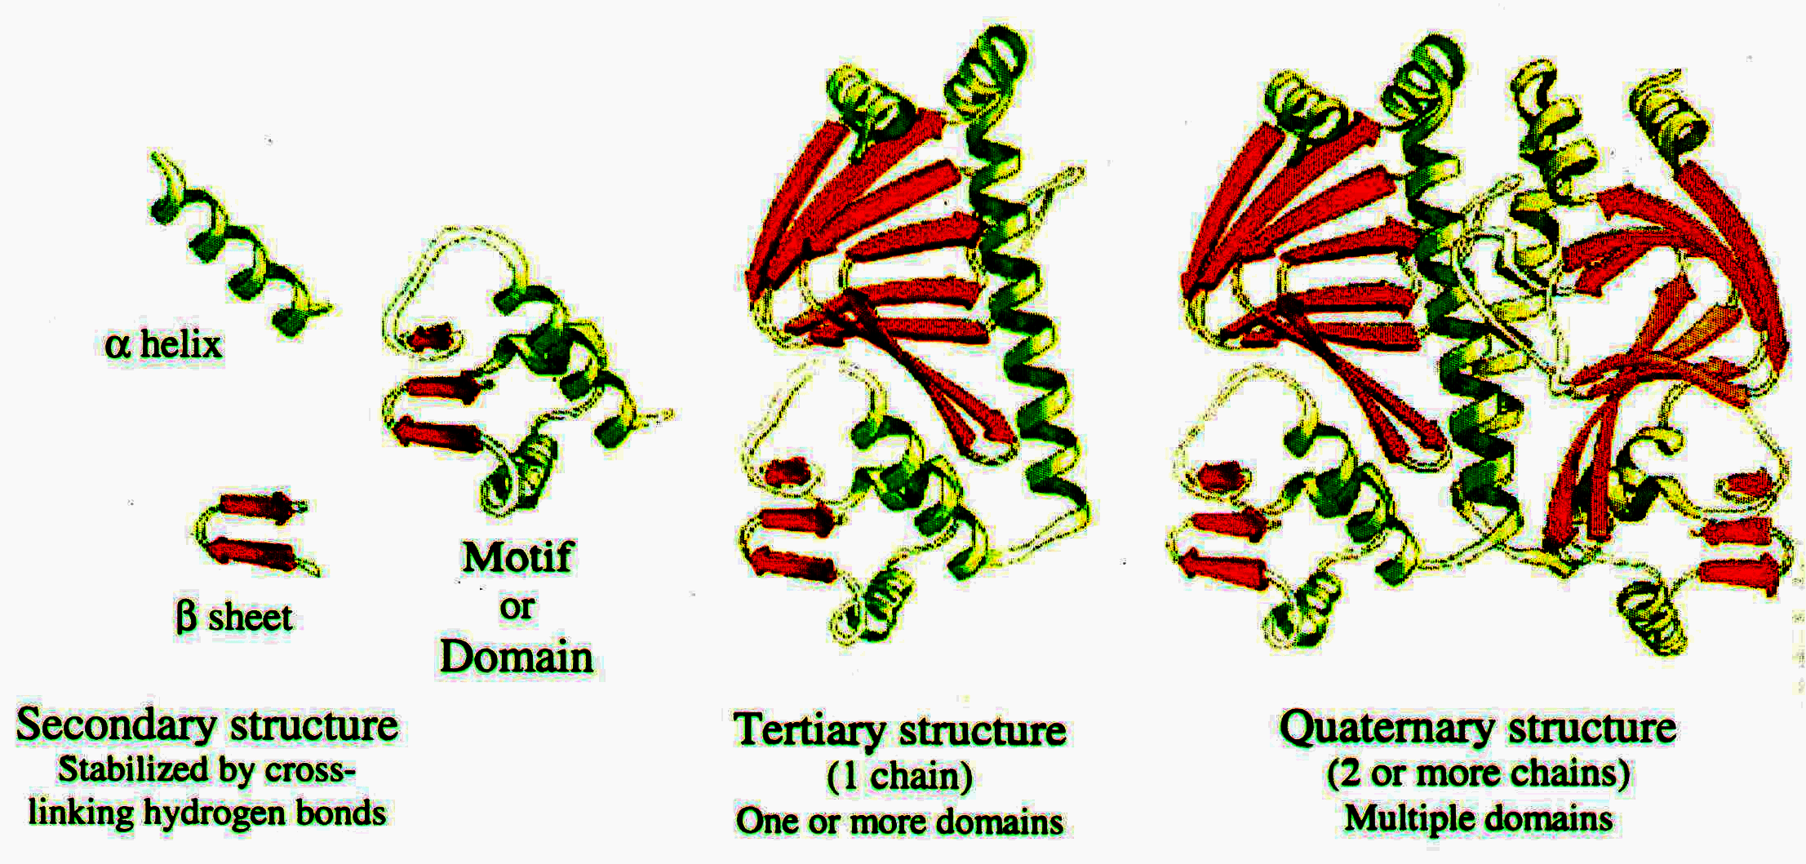
Introduction to Protein Structure
Regular Three Dimensional Structures
“One of the more astounding accomplishments of living cells is their ability to orchestrate and control specific chemical interactions between tens of thousands of proteins in the same reaction mixture” --- Richard Fine

Slide 14
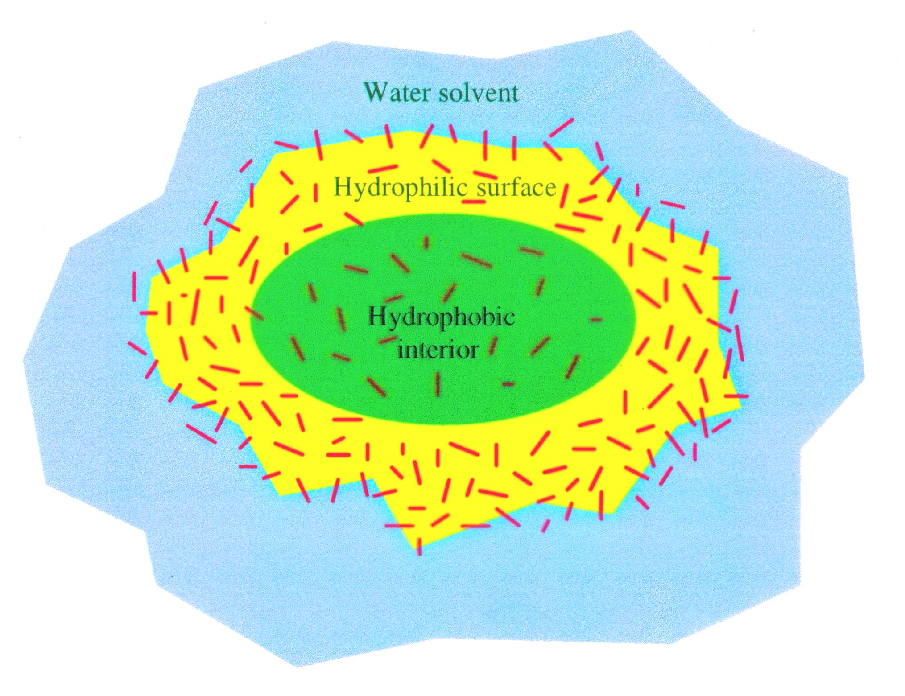
Introduction to Protein Dynamics
Molecular driving forces for protein folding

Slide 15
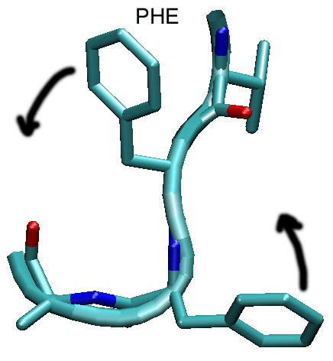
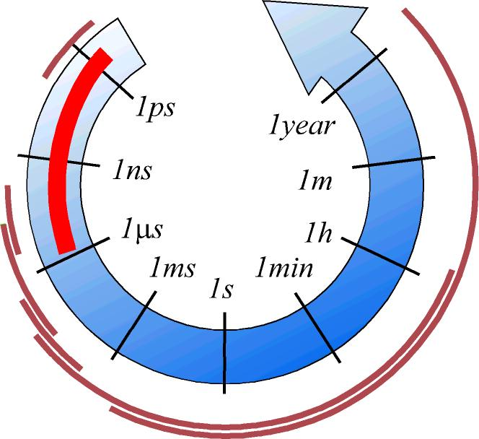
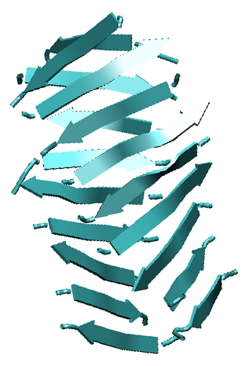
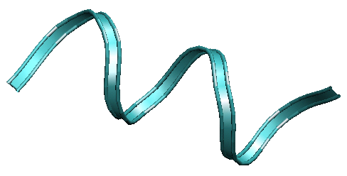
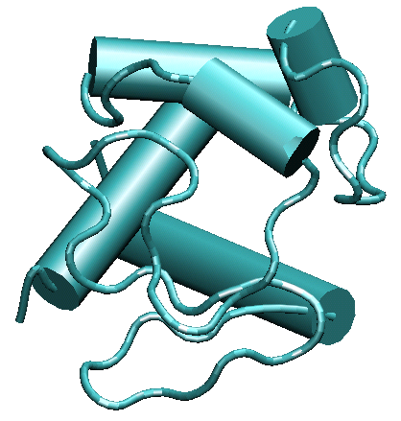
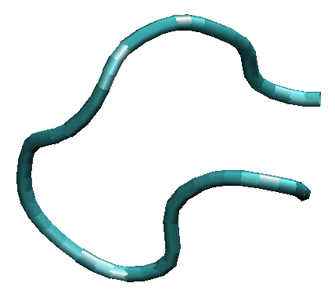
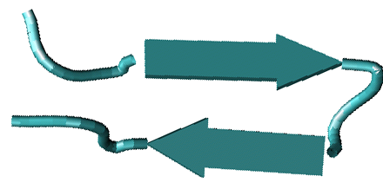
From Joan-Emma Shea
Time scales
Side-chain rotations
Loop closure
Protein aggregation
Protein folding
Helix formation
Folding of β-hairpins

Slide 16
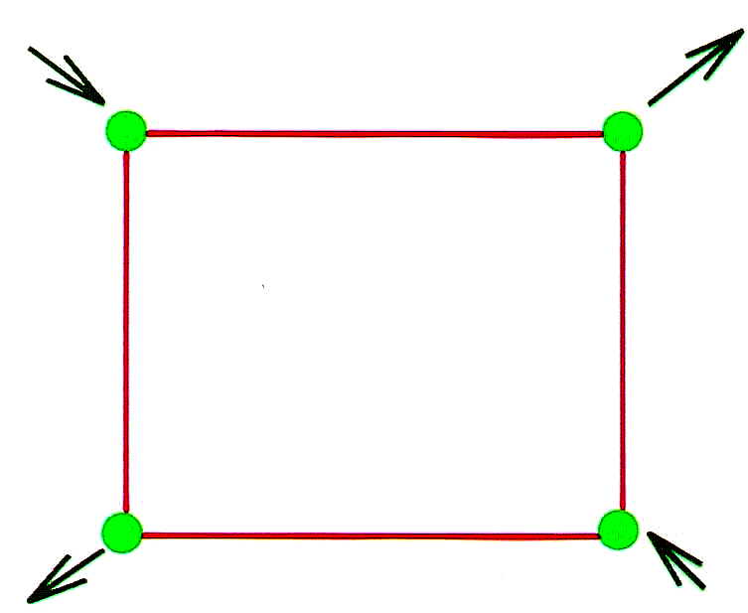
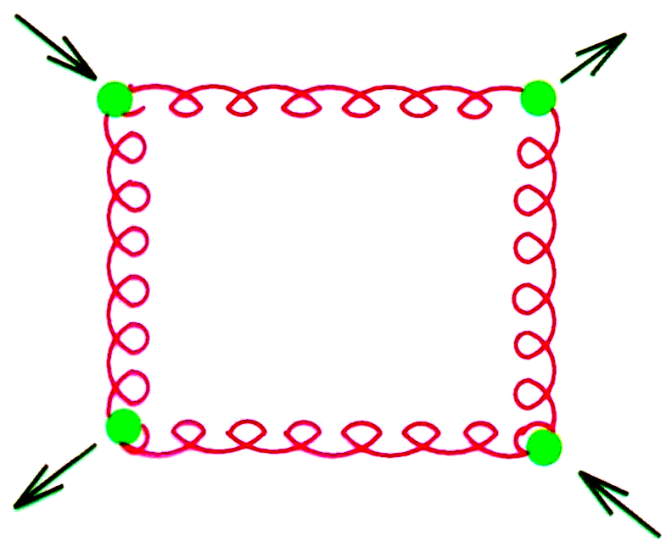
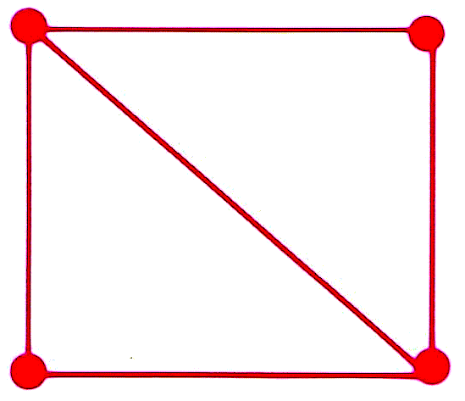
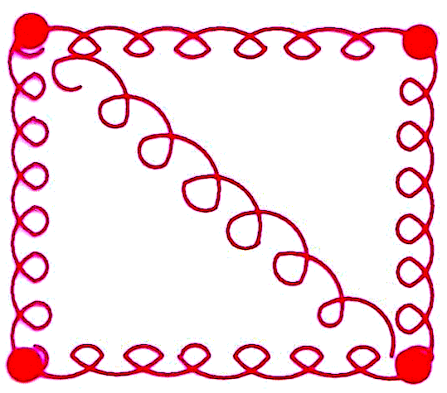
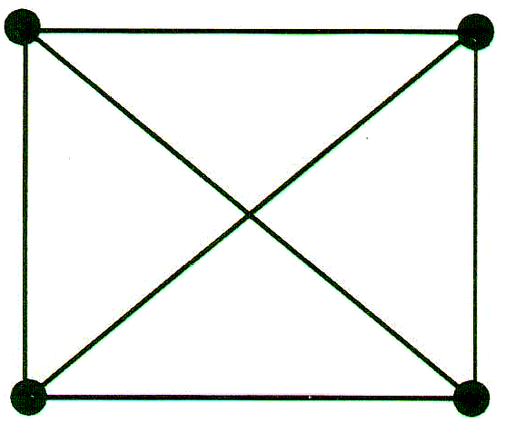
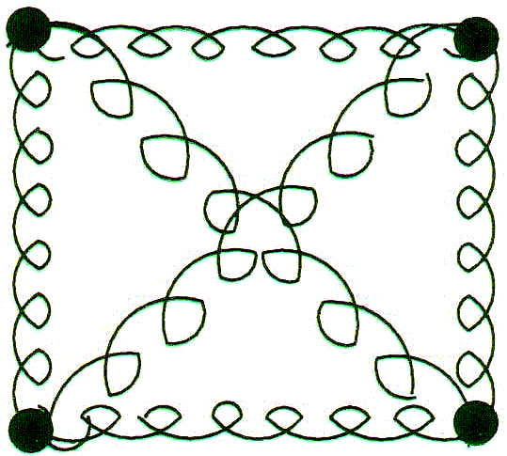
Introduction to Constraint Theory
Mechanics of Networks (2D example)
Static
Rigid bar networks
Dynamic
Spring networks
4 independent degrees of freedom
4 finite frequency modes
4 zero frequency modes
Rigid body
3 independent degrees of freedom
5 finite frequency modes
3 zero frequency modes
Over constrained
1 redundant bond
Generally stressed

Slide 17
Constraint Counting
Mean field estimate of mechanical stability in bar-joint structures
J. C. Maxwell, Philos. Mag. 27 294 (1864)
Global Estimate for Mechanical Stability
Free degrees of freedom estimate: F = dN – N_{c} Maxwell Constraint Counting
Honey Comb Lattice
f = F/N = d – z/2 = ½
f > 0 ⇒ Unstable
FLOPPY
NETWORK
Triangular Lattice
f = F/N = d – z/2 = -1
f < 0 ⇒ Stable
RIGID
NETWORK

Slide 18
Constraint Theory
Maxwell Constraint Counting
N particles
dN (DOF)
Nc constraints
uniformly distributed
Estimate of flexibility
add
dN
− Nc constraints
− d(d+1)/2 rigid body DOF
F = dN − Nc − d(d+1)/2
J. C. Maxwell, Philos. Mag. 27 294 (1864)
Bucket of 100 constraints
System of 50 DOF (degrees of freedom)
F
Apply
DOF
Rigidity Transition
0
25
50
75
100
Nc

Slide 19
Constraint Theory
The importance of the distribution of constraints
G. Laman, J. Eng. Math. 4, 331 (1970) → Complete combinatorial characterization in 2D
Isostatic Rigid Structure
Overconstrained
Floppy
^{Stable}
^{Unstable}
CORRECT
WRONG
Maxwell Constraint Counting
F = 2N − N_{c}
F = 2×6 – 9
F = 3 ⇒ Network is RIGID

Slide 20
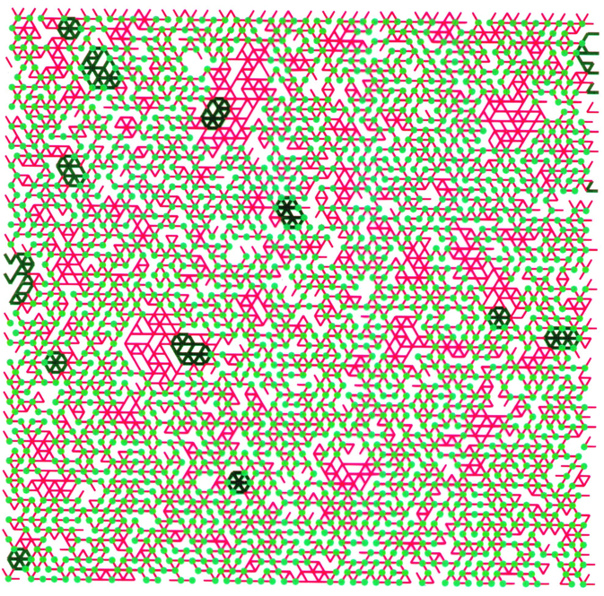
Constraint Theory
The long-range nature of network rigidity
Small section of a randomly bond diluted triangular lattice
2D Pebble Game Algorithm
Identification of independent constraints
Identification of rigid clusters
Identification of overconstrained regions
Identification of flexible regions
Jacobs & Hendrickson, J. Comput. Phys. 137, 346 (1997)
Jacobs & Thorpe, Phys. Rev. E 53, 3682 (1996)
Moukarzel, J. Phys. A: Math. Gen. 29, 8079 (1996)
Jacobs & Thorpe, Phys. Rev. Lett. 75, 4051 (1995)
Moukarzel & Duxbury, Phys. Rev. Lett. 75, 4056 (1995)
Two Dimensional Example:
Constraint topology below rigidity transition
Globally floppy

Slide 21
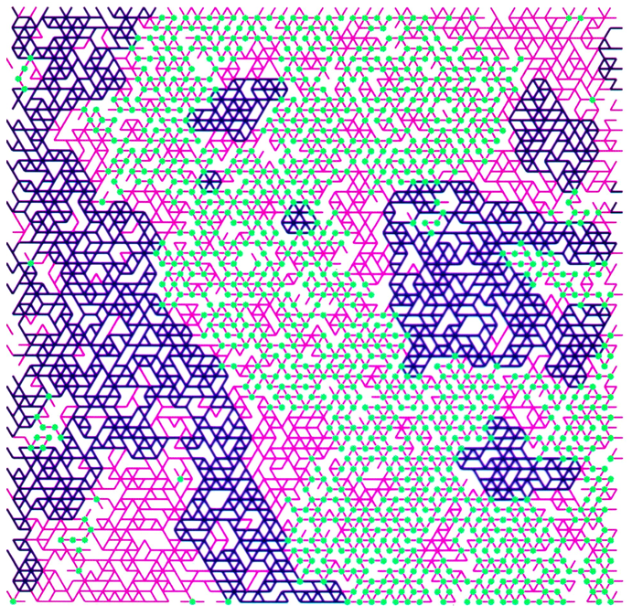
Constraint Theory
The long-range nature of network rigidity
Small section of a randomly bond diluted triangular lattice
2D Pebble Game Algorithm
Identification of independent constraints
Identification of rigid clusters
Identification of overconstrained regions
Identification of flexible regions
Jacobs & Hendrickson, J. Comput. Phys. 137, 346 (1997)
Jacobs & Thorpe, Phys. Rev. E 53, 3682 (1996)
Moukarzel, J. Phys. A: Math. Gen. 29, 8079 (1996)
Jacobs & Thorpe, Phys. Rev. Lett. 75, 4051 (1995)
Moukarzel & Duxbury, Phys. Rev. Lett. 75, 4056 (1995)
Two Dimensional Example:
Constraint topology at the rigidity transition
Globally rigid

Slide 22
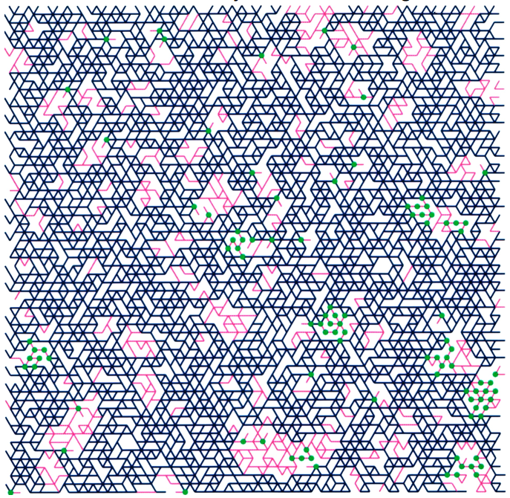
Constraint Theory
The long-range nature of network rigidity
Small section of a randomly bond diluted triangular lattice
2D Pebble Game Algorithm
Identification of independent constraints
Identification of rigid clusters
Identification of overconstrained regions
Identification of flexible regions
Jacobs & Hendrickson, J. Comput. Phys. 137, 346 (1997)
Jacobs & Thorpe, Phys. Rev. E 53, 3682 (1996)
Moukarzel, J. Phys. A: Math. Gen. 29, 8079 (1996)
Jacobs & Thorpe, Phys. Rev. Lett. 75, 4051 (1995)
Moukarzel & Duxbury, Phys. Rev. Lett. 75, 4056 (1995)
Two Dimensional Example:
Constraint topology above rigidity transition
Globally overconstrained

Slide 23
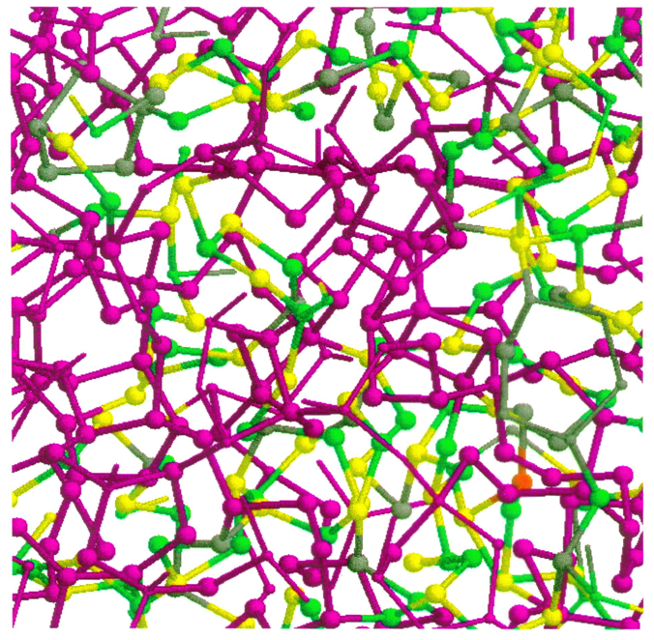
Constraint Theory
Application to covalent bond network glasses
Small section of a randomly bond diluted diamond lattice
3D Pebble Game Algorithm
Identification of independent constraints
Identification of rigid clusters
Identification of overconstrained regions
Identification of flexible regions
Jacobs, J. Phys. A: Math. Gen. 31, 6653 (1998)
Whiteley, Contemp. Math. 197, 171 (1996)
Tay and Whiteley, Structural Topology 9, 31 (1984)
Tay, J. Comb. Theory B 26, 95 (1984)
Three Dimensional Example:
Constraint topology above rigidity transition
M.F. Thorpe, J. Non-Cryst. Solids 57, 355 (1983)
J. C. Phillips, J. Non-Cryst. Solids 34, 153 (1979)
Macroscopic concepts
applied to atomic structure
Requires separation of hard & soft forces

